Slide 1
Intermolecular Forces
INTERMOLECULAR FORCES

Slide 2
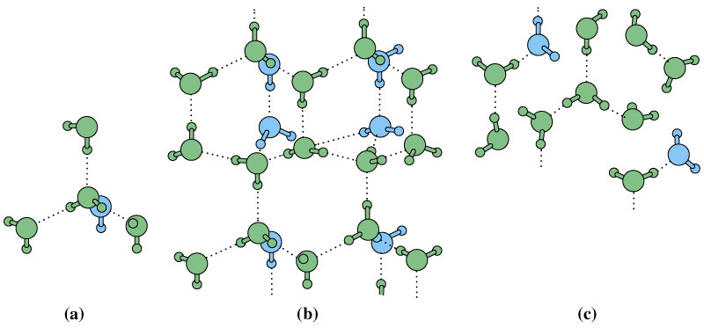
INTERMOLECULAR FORCES
These are forces between molecules and therefore only concern covalent molecular substances.
They are forces between molecules and not within the molecule (ie. not Covalent bonds)
Eg. Consider molecules of water in an ice crystal or snow flake.
These are covalent bonds (within the molecule),
while these are intermolecular forces.

Slide 3
INTERMOLECULAR FORCES
Despite covalent bonds within molecular substances being strong, the intermolecular forces between neighbouring molecules is quite weak. This is evidenced by the low melting and boiling points of most covalent molecular substances.
These weak intermolecular forces, or van der Waals forces, can be classified into three types based on polarity* :-
  Dipole-dipole forces
  Dispersion forces
  Hydrogen bonding
*You may need to refresh your memory on by revisiting the “Electronegativity & Polarity” PowerPoint tutorial or that section of your notes

Slide 4
Relative strengths of the Intermolecular Forces
Generally hydrogen bonding is the strongest intermolecular force, dipole-dipole forces are the next strongest and dispersion forces are the weakest of the intermolecular forces.
Hydrogen bonding > dipole-dipole > dispersion forces
The relative strengths can be illustrated by a comparison of the boiling points of some hydrogen containing molecules.
Substance | Intermolecular Force | Boiling Point
H₂ | Dispersion | -253ºC
HCl | Dipole-dipole | -85ºC
HF | Hydrogen Bonding | 20ºC

Slide 5
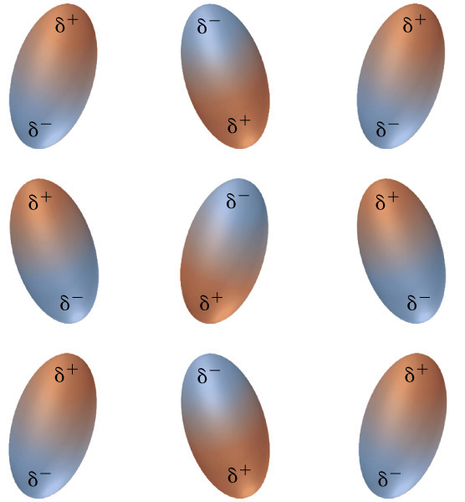
Dipole-Dipole Forces
Dipole-dipole forces - only polar covalent molecules have the ability to form dipole-dipole attractions between molecules. Polar covalent molecules act as little magnets, they have positive ends and negative ends which attract each other.
Dipoles tend to arrange themselves with the positive end of one dipole pointed toward the negative end of a neighbouring dipole. Ordinarily, thermal motion upsets this orderly array but as the freezing point is approached the molecules slow and align in a regular formation.

Slide 6
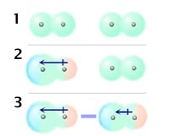
Dispersion Forces
Dispersion forces - These result from the movement of the electrons in the molecule which generates temporary positive and negative regions in the molecule. Hence even non-polar molecules can have temporary dipoles.
All molecules have the capability to form dispersion forces. Generally the larger the molecule the larger the dispersion forces. These are the only types of forces that non-polar covalent molecules can form.
Temporary dipole Dispersion Force
Eg. A non-polar molecule (1) develops a temporary dipole due to uneven electron distribution (2), this induces a dipole in a neighbouring molecule (3) and a dispersion force between them results.

Slide 7
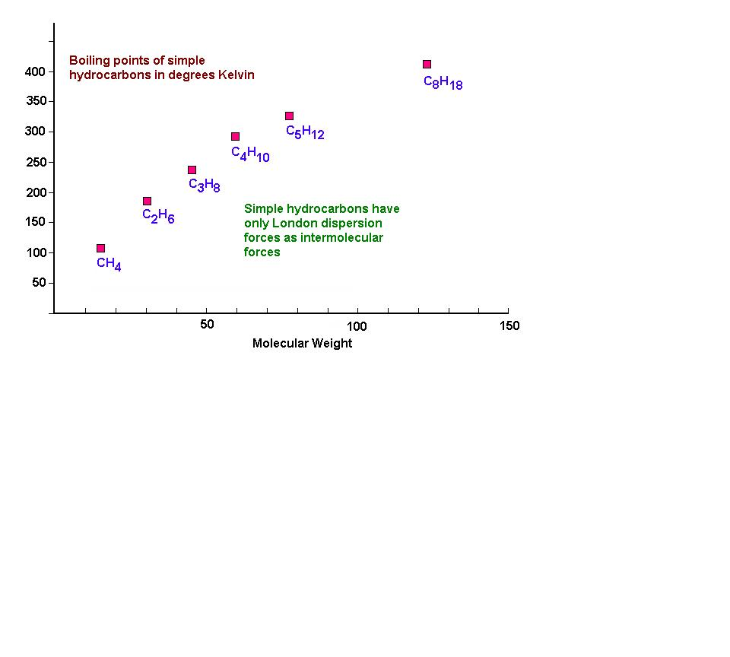
Dispersion Forces & Boiling & Melting Points
Generally the larger the molecule the larger the dispersion forces. This is clearly indicated by a study of the boiling points of the hydrocarbons (which are non-polar so only have dispersion forces).

Slide 8
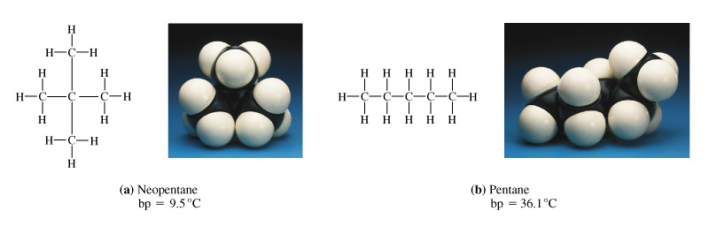
Dispersion Forces & Boiling & Melting Points…ctd
Molecular shapes also effects boiling and melting points.
Eg. Two C₅H₁₂ isomers
2,2-dimethyl propane, bp 9.5ºC pentane, bp 36.1ºC
The elongated pentane molecule is more easily polarized (it is more exposed) than the compact 2,2-dimethyl propane isomer molecule. Intermolecular forces are stronger in pentane so it boils at a higher temperature than 2,2-dimethyl propane.

Slide 9
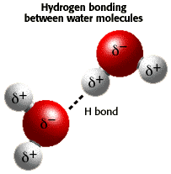
Hydrogen Bonding
Hydrogen bonding - occurs between polar covalent molecules that possess a hydrogen bonded to an extremely electronegative element, specifically - N, O, and F.
Effectively they are a stronger than usual type of dipole-dipole force.
Eg. Hydrogen bonding between water molecules is stronger than the dipole-dipole forces in other molecules. This will later help us explain some of waters unusual properties.
NB: Although called a hydrogen ‘bond’,
it is still an intermolecular force.

Slide 10
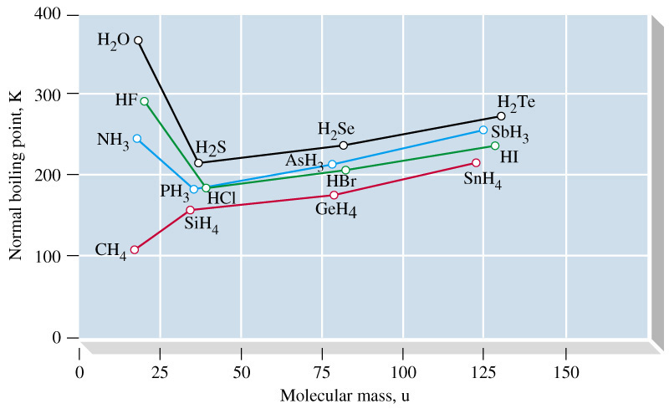
Hydrogen Bonding - ctd
A comparison of the boiling points of some hydrides of the elements of Groups 4, 5, 6, & 7 shows the values for NH₃, H₂O & HF are unusually high compared with those of other members of their groups. This provides evidence for Hydrogen bonding

Slide 11
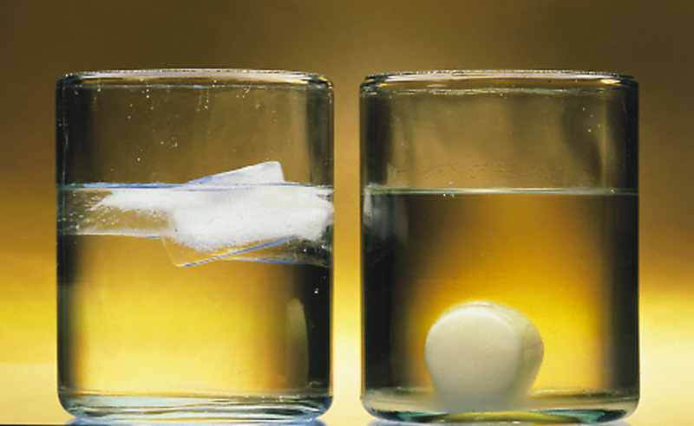
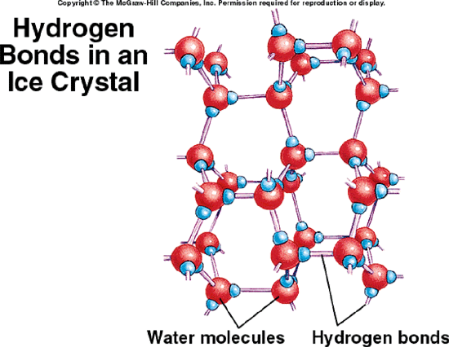
Hydrogen Bonding in Water
Apart from a higher than usual boiling the strong forces of the hydrogen bonding in water force its molecules to align in a quite inefficient way as it freezes. This results in ice being less dense than water. For most other substances the solid is more dense than the corresponding liquid.
Large spaces
Ice in water Wax in molten wax Ice structure

Slide 12
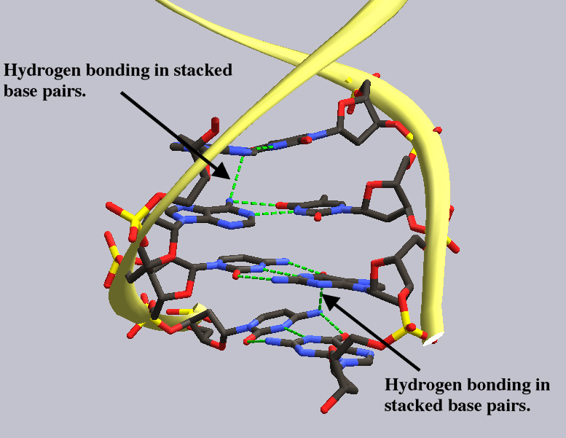
Hydrogen Bonding in DNA
Hydrogen bonding also plays an important role in DNA.

Slide 13
Combinations of Intermolecular Forces
A comparison of boiling points of some hydrogen halides yields some unexpected results. We would expect the values for HCl, HBr, and HI to decrease if only dipole-dipole forces were involved since as we go down the halides group the electonegativity decreases. Obviously the increasing dispersion forces due to increasing size also have a significant effect.

Slide 14
